Slide 1
Passenger and Freight Railroad Employee Data
Theodora Cheng
Andrea Curo
Sonam Shah

Slide 2
The Data - Description
Survey of freight and railroad employees
Background of Employees
Alertness and Sleep Ratings of Employees
Activity Data

Slide 3
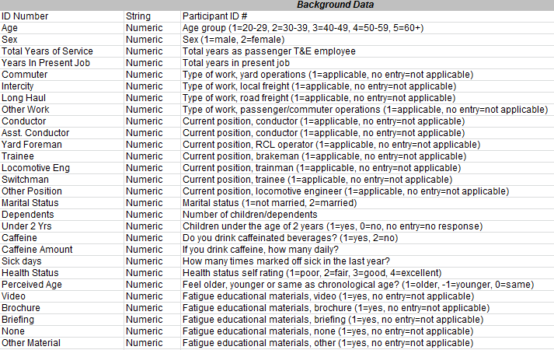
Table 1 Background Data
ID Number

Slide 4
Table 1 Background Data
Age

Slide 5
Table 1 Background Data
Sex

Slide 6
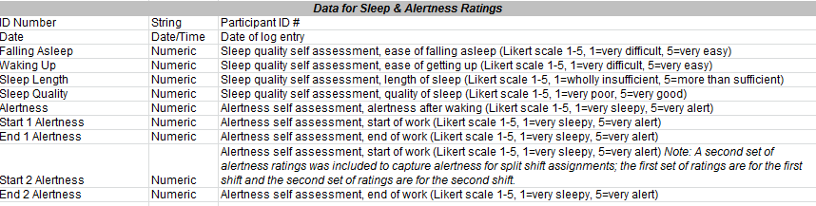
Table 2 Data for Sleep & Alertness Ratings
ID

Slide 7
Table 2 Data for Sleep & Alertness Ratings
Sleep Quality

Slide 8
Table 2 Data for Sleep & Alertness Ratings
Alertness

Slide 9
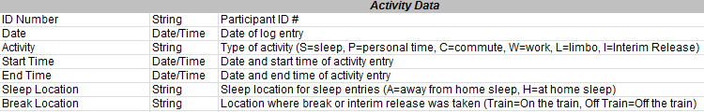
Table 3 Activity Data
ID

Slide 10
Table 3 Activity Data
Sleep Location

Slide 11
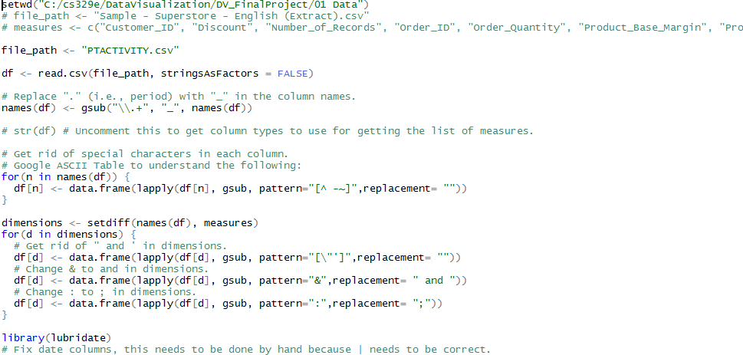
The Data - Processing
Separate
Reformat

Slide 12
Data Wrangling

Slide 13
Creation of Data Frames
df_background <- data.frame(fromJSON(getURL(URLencode('129.152.144.84:5001/rest/native/?
query="select * from tbackground"'),httpheader=c(DB='jdbc:oracle:thin:@129.152.144.84:1521:
ORCL', USER='C##cs329e_thc359', PASS='orcl_thc359', MODE='native_mode', MODEL='model', returnDimensions = 'False', returnFor = 'JSON'), verbose = TRUE)))
df_sleepalert <- data.frame(fromJSON(getURL(URLencode('129.152.144.84:5001/rest/native/?
query="select * from tsleepalert"'),httpheader=c(DB='jdbc:oracle:thin:@129.152.144.84:1521:
ORCL', USER='C##cs329e_thc359', PASS='orcl_thc359', MODE='native_mode', MODEL='model', returnDimensions = 'False', returnFor = 'JSON'), verbose = TRUE)))
df_activity <- data.frame(fromJSON(getURL(URLencode('129.152.144.84:5001/rest/native/?
query="select * from tactivity"'),httpheader=c(DB='jdbc:oracle:thin:@129.152.144.84:1521:
ORCL', USER='C##cs329e_thc359', PASS='orcl_thc359', MODE='native_mode', MODEL='model', returnDimensions = 'False', returnFor = 'JSON'), verbose = TRUE)))

Slide 14

Creation of Data Frames
df_background <- data.frame(fromJSON(getURL(URLencode('129.152.144.84:5001/rest/native/?
query="select * from tbackground"'),httpheader=c(DB='jdbc:oracle:thin:@129.152.144.84:1521:
ORCL', USER='C##cs329e_thc359', PASS='orcl_thc359', MODE='native_mode', MODEL='model', returnDimensions = 'False', returnFor = 'JSON'), verbose = TRUE)))
df_sleepalert <- data.frame(fromJSON(getURL(URLencode('129.152.144.84:5001/rest/native/?
query="select * from tsleepalert"'),httpheader=c(DB='jdbc:oracle:thin:@129.152.144.84:1521:
ORCL', USER='C##cs329e_thc359', PASS='orcl_thc359', MODE='native_mode', MODEL='model', returnDimensions = 'False', returnFor = 'JSON'), verbose = TRUE)))
df_activity <- data.frame(fromJSON(getURL(URLencode('129.152.144.84:5001/rest/native/?
query="select * from tactivity"'),httpheader=c(DB='jdbc:oracle:thin:@129.152.144.84:1521:
ORCL', USER='C##cs329e_thc359', PASS='orcl_thc359', MODE='native_mode', MODEL='model', returnDimensions = 'False', returnFor = 'JSON'), verbose = TRUE)))

Slide 15
Average Caffeine Level vs Alertness
Caffeine Amount
Level of caffeine
(If you drink caffeine, how many daily?)
Alertness
Alertness after waking
(1-5, 1=very sleepy, 5=very alert)

Slide 16
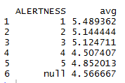
Average Caffeine Level vs Alertness
dfd <- inner_join(df_sleepalert, df_background, by="ID_NUMBER")
dfe <- dfd %>% select(ID_NUMBER, ALERTNESS, CAFFEINE_AMOUNT) %>% group_by(ALERTNESS) %>% summarise(avg=mean(CAFFEINE_AMOUNT))

Slide 17
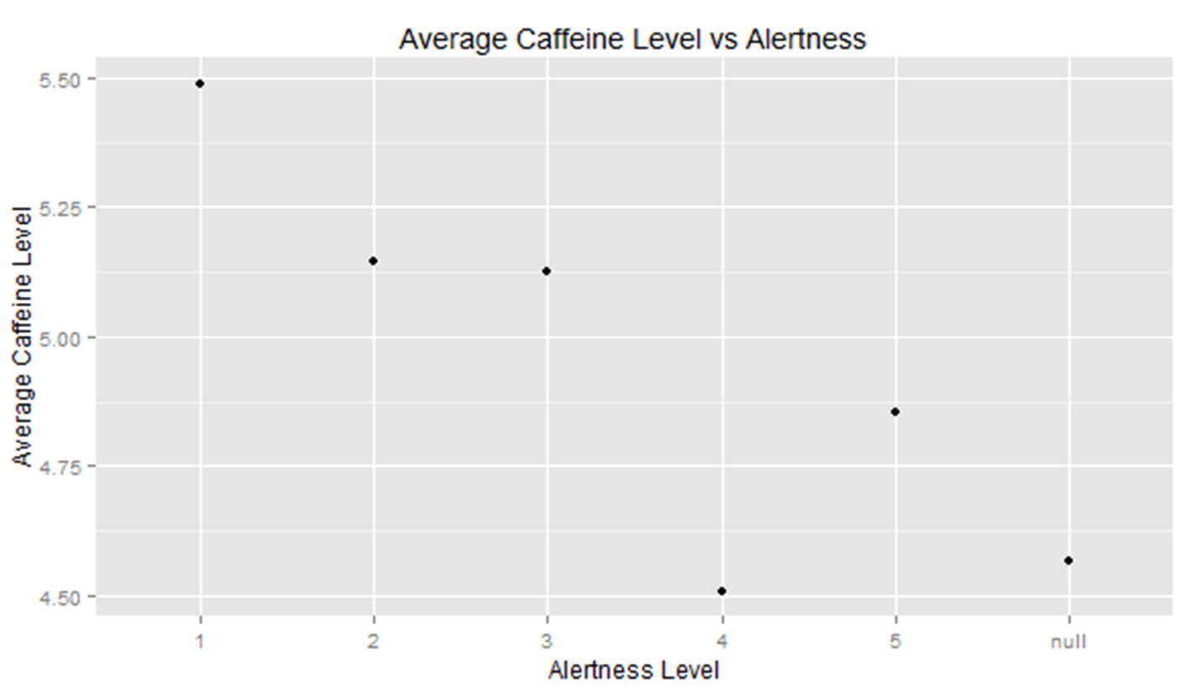
Average Caffeine Level vs Alertness
g <- ggplot(dfe, aes(x=ALERTNESS, y=avg)) + geom_point()
g + theme(legend.position="none") + labs(x="Alertness Level", y="Average Caffeine Level", title="Average Caffeine Level vs Alertness")

Slide 18
Sleep Quality Compared to Activity Type
Activity
Type of activity
(S=sleep, P=personal time, C=commute, W=work,
L=limbo, I=Interim Release)
Sleep Quality
Self assessment, quality of sleep
(1-5, 1=very poor, 5=very good)

Slide 19
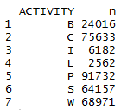
Sleep Quality Compared to Activity Type
dfe <- left_join(df_sleepalert, df_activity, by="ID_NUMBER")
dfe %>% select(ID_NUMBER, ACTIVITY) %>% group_by(ACTIVITY) %>% count(ACTIVITY)

Slide 20
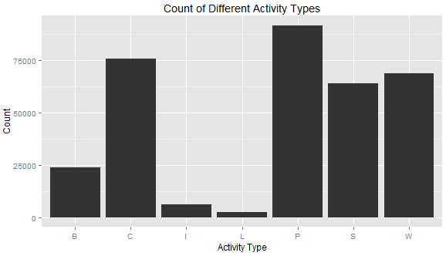
Sleep Quality Compared to Activity Type
g <- ggplot(dfe, aes(ACTIVITY)) + geom_bar()
g + geom_bar(width=.7) + theme(legend.position="none") + labs(x="Activity Type", y="Count", title="Count of Different Activity Types")

Slide 21
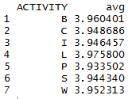
Sleep Quality Compared to Activity Type
dff <- dfe %>% select(ID_NUMBER, SLEEP_QUALITY, ACTIVITY) %>% group_by(ACTIVITY) %>% summarise(avg=mean(SLEEP_QUALITY))

Slide 22
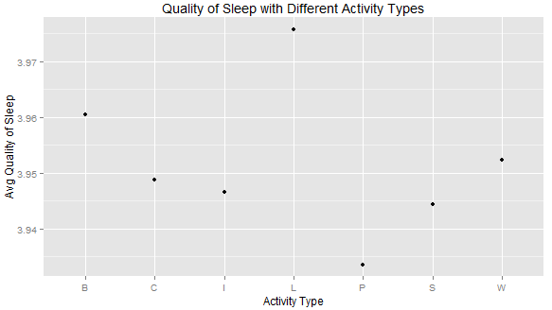
Sleep Quality Compared to Activity Type
g <- ggplot(dff, aes(x=ACTIVITY, y=avg)) + geom_point()
g + theme(legend.position="none") + labs(x="Activity Type", y="Avg Quality of Sleep", title="Quality of Sleep with Different Activity Types")

Slide 23
Alertness Levels Compared to Schedule Type
SchedType
Type of Schedule
(Straight Thru, Split Shift, or Extra Board)
Alertness
Alertness after waking
(1-5, 1=very sleepy, 5=very alert)

Slide 24
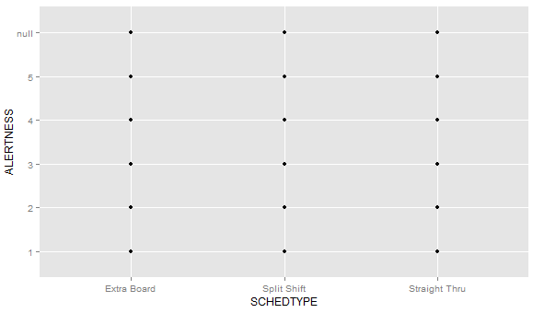
Alertness Levels Compared to Schedule Type
dfc <- inner_join(df_sleepalert, df_background, by="ID_NUMBER")
dfc %>% select(SCHEDTYPE, ALERTNESS) %>% group_by(SCHEDTYPE) %>% ggplot(aes(x=SCHEDTYPE, y=ALERTNESS)) + geom_point()
Notes:
Adding noise to data, so careful for misinterpretation, but can see how many actual workers chose these

Slide 25
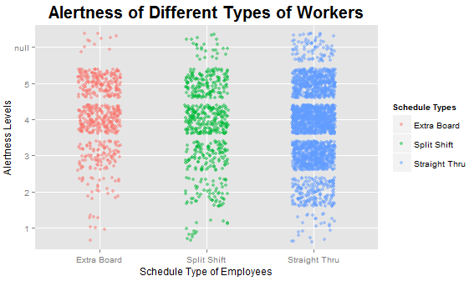
Alertness Levels Compared to Schedule Type
dfc %>% select(SCHEDTYPE, ALERTNESS) %>% group_by(SCHEDTYPE) %>% ggplot(aes(x=
SCHEDTYPE, y=ALERTNESS)) + geom_jitter(alpha=0.5,aes(color=SCHEDTYPE),position=
position_jitter(width=.2)) + ggtitle('Alertness of Different Types of Workers')+theme(plot.title=
element_text(size=20,face="bold",vjust=1,lineheight=0.6)) + labs(x = 'Schedule Type of Employees', y = 'Alertness Levels') + scale_color_discrete(name="Schedule Types")
Notes:
Adding noise to data, so careful for misinterpretation, but can see how many actual workers chose these

Slide 26
Sleep Quality and Length Compared to Job Length
Years In Present Job
Total years in present job
Sleep Length
Self assessment, length of sleep
(1-5, 1=wholly insufficient, 5=more than sufficient)
Sleep Quality
Self assessment, quality of sleep
(1-5, 1=very poor, 5=very good)

Slide 27
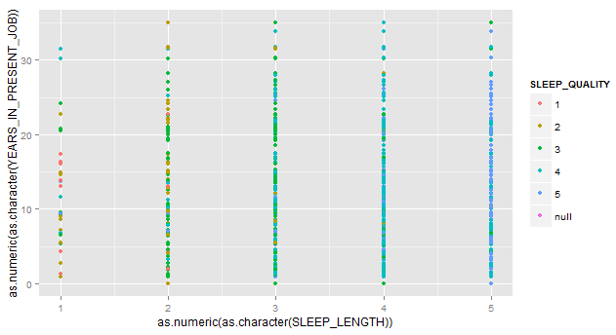
Sleep Quality and Length Compared to Job Length
dfc <- right_join(df_sleepalert, df_background, by="ID_NUMBER")
dfc %>% select(YEARS_IN_PRESENT_JOB, SLEEP_LENGTH, SLEEP_QUALITY) %>% group_by(SLEEP_QUALITY) %>% ggplot(aes(as.numeric(as.character (SLEEP_LENGTH)), as.numeric(as.character(YEARS_IN_PRESENT_JOB)), color = SLEEP_QUALITY))+geom_point()

Slide 28
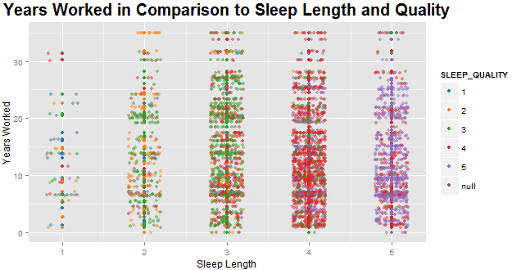
Sleep Quality and Length Compared to Job Length
dfc %>% select(YEARS_IN_PRESENT_JOB, SLEEP_LENGTH, SLEEP_QUALITY) %>% group_by(SLEEP_QUALITY) %>% ggplot(aes(as.numeric(as.character(SLEEP_LENGTH)), as.numeric(as.character(YEARS_IN_PRESENT_JOB)), color = SLEEP_QUALITY))+geom_point() + ggtitle('Years Worked in Comparison to Sleep Length and Quality') +theme(plot.title=element_text(size=20,face="bold",vjust=1,lineheight=0.6)) + labs(x = 'Sleep Length', y = 'Years Worked') + geom_jitter(alpha=0.5,aes(color=SLEEP_QUALITY),position= position_jitter(width=.2)) + scale_colour_tableau()

Slide 29
Years Worked vs Job Security and New Hire Oversight
Sex
(1=male, 2=female)
Total Years of Service
Total years as passenger T&E employee
Job Security
Stress due to job security
(1=no stress, 2=a little stress, 3=stressful, 4=very stressful)
New Hire Oversight
Stress due to oversight of new hires
(1=no stress, 2=a little stress, 3=stressful, 4=very stressful)

Slide 30
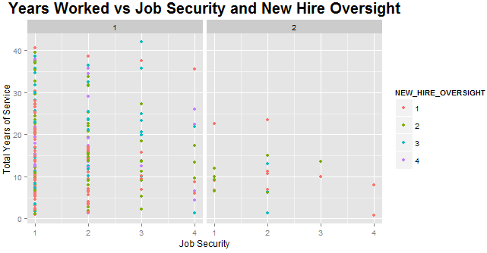
Years Worked vs Job Security and New Hire Oversight
df_background %>% group_by(TOTAL_YEARS_OF_SERVICE, NEW_HIRE_OVERSIGHT, JOB_SECURITY, SEX) %>% ggplot(aes(x= as.numeric(as.character(JOB_SECURITY)), y=as.numeric(as.character(TOTAL_YEARS_ OF_SERVICE)), color=NEW_HIRE_ OVERSIGHT)) + geom_point() + facet_wrap(~SEX) + ggtitle('Years Worked vs Job Security and New Hire Oversight') +theme(plot.title=element_text(size=20,face="bold“ ,vjust=1,lineheight=0.6)) + labs(x = 'Job Security', y = 'Total Years of Service')

Slide 31
Tableau Getting Data from Oracle

Slide 32
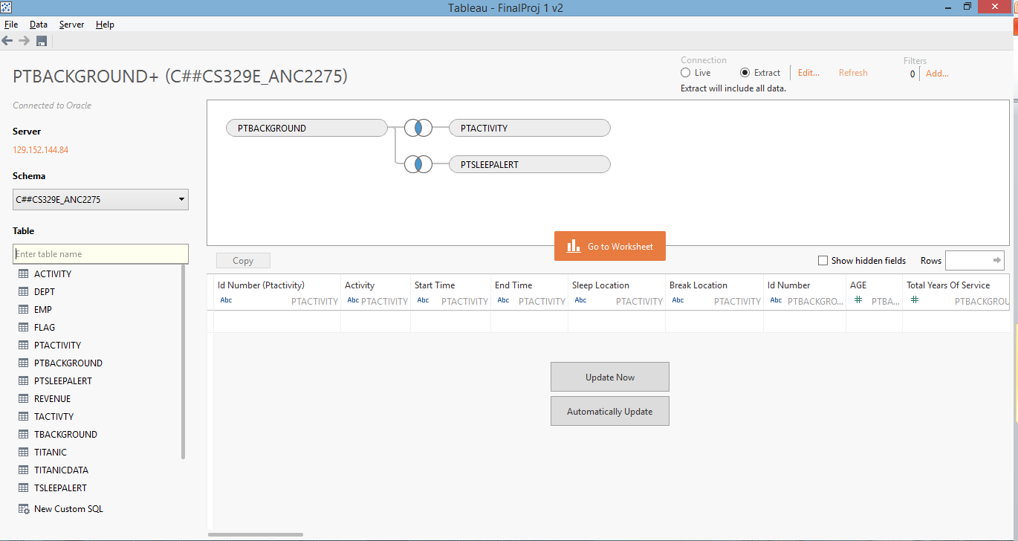
Data Source
Pulled data from Oracle and linked each table by ID number of employees

Slide 33
Data Blending

Slide 34
Sleep Quality vs Sleep Location/Length
Sleep Quality
Quality of sleep
(1-5, 1=very poor, 5=very good)
Sleep Location
Sleep location for sleep entries
(A=away from home sleep, H=at home sleep)
Sleep Length
Length of Sleep
(1-5, 1=wholly insufficient, 5=more than sufficient)

Slide 35
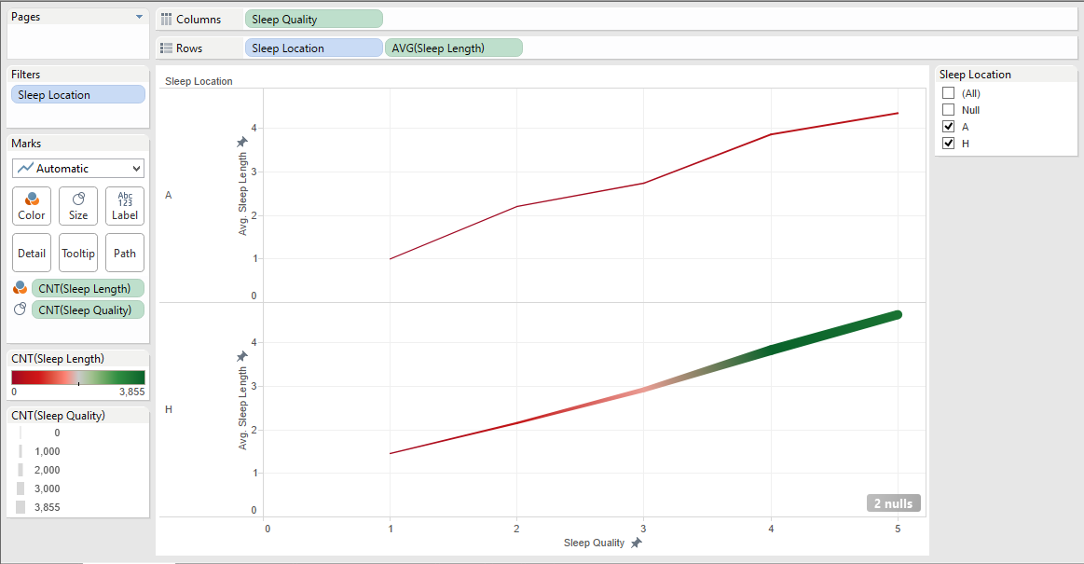
Sleep Quality vs Sleep Location/Length
Columns - Sleep Quality

Slide 36
Sleep Quality vs Sleep Location/Length
Rows – Sleep Location, AVG(Sleep Length)

Slide 37
Sleep Quality vs Sleep Location/Length
Filtered out NULL sleep locations

Slide 38
Sleep Quality vs Sleep Location/Length
COLOR – how many employees at each sleep length

Slide 39
Sleep Quality vs Sleep Location/Length
SIZE – how many employees at each sleep quality

Slide 40
Sleep Quality vs Sleep Location/Length
*Color (greener) – More employees sleep at home at sleep length 3-5

Slide 41
Visualization 1
*Size (thicker) – More employees sleep at home at sleep quality 3-5

Slide 42
Sleep Quality vs Sleep Location/Length
*In this sample size, more employees tend to sleep at a higher quality (3-5) with a higher sleep length (3-5) at home

Slide 43
Sleep Quality vs Sleep Location/Length
*At sleep quality 1, sleep length averages at 1 away from home

Slide 44
Sleep Quality vs Sleep Location/Length
*At sleep quality 1, sleep length averages at 1.45 at home

Slide 45
Sleep Quality vs Sleep Location/Length
*On average, at sleep quality 1, employees need 0.45 more sleep at home

Slide 46
Sleep Quality vs Sleep Location/Length
*At sleep quality 5, sleep length averages at 4.3 away from home

Slide 47
Sleep Quality vs Sleep Location/Length
*At sleep quality 5, sleep length averages at 4.6 at home

Slide 48
Sleep Quality vs Sleep Location/Length
*On average, at sleep quality 5, employees need 0.3 more sleep at home

Slide 49
Sleep Quality vs Sleep Location/Length
*Although slight differences in sleep length at the low and high of each sleep quality, there appears to be a near 1 to 1 relation between sleep quality and sleep length regardless of sleep location

Slide 50
Caffeine Amount vs Start/End Alertness
Caffeine Amount
If drink caffeine, how many daily
Start Alertness
Alertness at start of work
(1-5, 1=very sleepy, 5=very alert)
End Alertness
Alertness at end of work
(1-5, 1=very sleepy, 5=very alert)

Slide 51
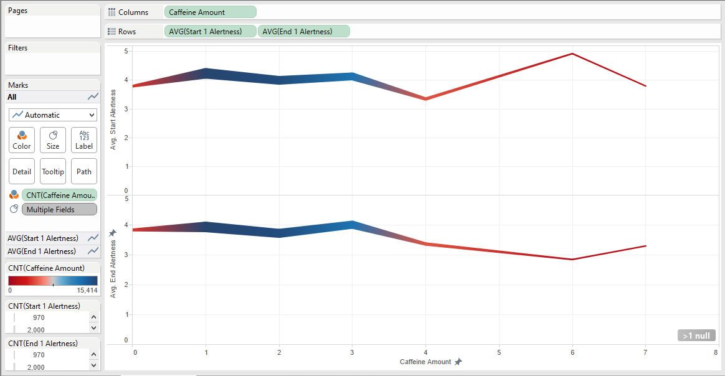
Caffeine Amount vs Start/End Alertness
Columns – Caffeine Amount

Slide 52
Caffeine Amount vs Start/End Alertness
Rows – AVG(Start Alertness), AVG(End Alertness)

Slide 53
Caffeine Amount vs Start/End Alertness
COLOR – how many employees at each caffeine amount

Slide 54
Caffeine Amount vs Start/End Alertness
SIZE – how many employees at each start/end alertness

Slide 55
Caffeine Amount vs Start/End Alertness
*Color (bluer) – More employees drink 1-3 cups of coffee

Slide 56
Caffeine Amount vs Start/End Alertness
*Size (thicker) – More employees have alertness around 4

Slide 57
Caffeine Amount vs Start/End Alertness
*From caffeine amount 1-3, average alertness is 4

Slide 58
Caffeine Amount vs Start/End Alertness
*After 3 cups of coffee, the average start alertness drops down to 3.35 and average end alertness drops down to 3.36

Slide 59
Caffeine Amount vs Start/End Alertness
*At 6 cups of coffee, the average start alertness spikes to 4.9

Slide 60
Caffeine Amount vs Start/End Alertness
*And at 6 cups of coffee, the average end alertness drops to 2.8

Slide 61
Caffeine Amount vs Start/End Alertness
*Caffeine amount 6 has 2.1 average difference in start and end alertness – the largest drop from start to end alertness

Slide 62
Caffeine Amount vs Start/End Alertness
*1-3 cups of caffeine shows the highest average start/end alertness with the smallest difference in start to end alertness

Slide 63
Years in Present Job vs Stress
Years in Present Job
Total years in present job
Work Schedule
Stress due to lack of control over work schedule
(1=no stress, 2=a little stress, 3=frequently, 4=always)
Job Security
Stress due to job security
(1=no stress, 2=a little stress, 3=frequently, 4=always)
Staffing
Stress due to inadequate staffing
(1=no stress, 2=a little stress, 3=frequently, 4=always)

Slide 64
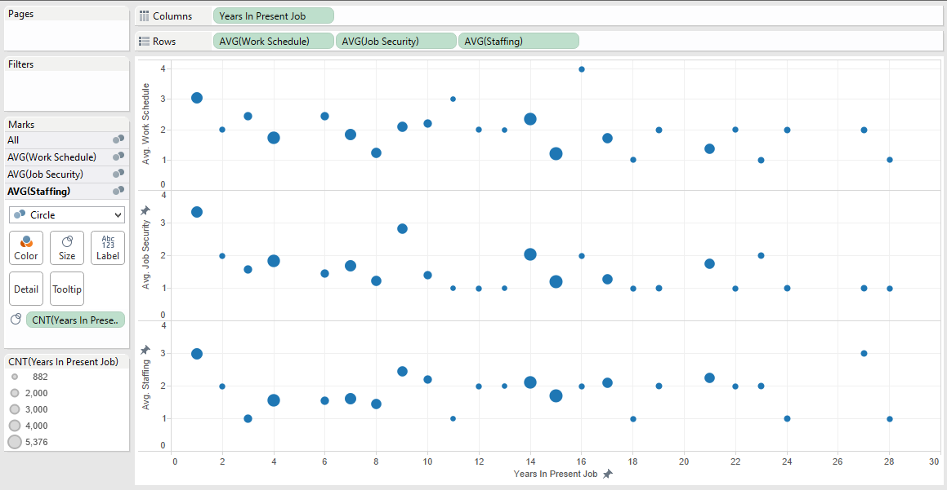
Years in Present Job vs Stress
Columns – Years in Present Job

Slide 65
Years in Present Job vs Stress
Rows – Avg(Work Schedule) Avg(Job Security), Avg(Staffing)

Slide 66
Years in Present Job vs Stress
Size – how many employees per years worked in present job

Slide 67
Years in Present Job vs Stress
*After 16 years in present job, work schedule stress drops to 2 or below

Slide 68
Years in Present Job vs Stress
*After 9 years in present job, job security stress drops to 2 or below

Slide 69
Years in Present Job vs Stress
*After 1 year in present job, inadequate staffing stress drops to 2.5 or below and spikes back up in year 27

Slide 70
Years in Present Job vs Stress
*The overall stress levels drop after year 16, with number of employees decreasing as well

Slide 71
Age vs Weekly Work Hours
Age
Age group
(1=20-29,2=30-39, 3=40-49, 4=50-59, 5=60+)
Weekly Work Hours
Average number of hours per week

Slide 72
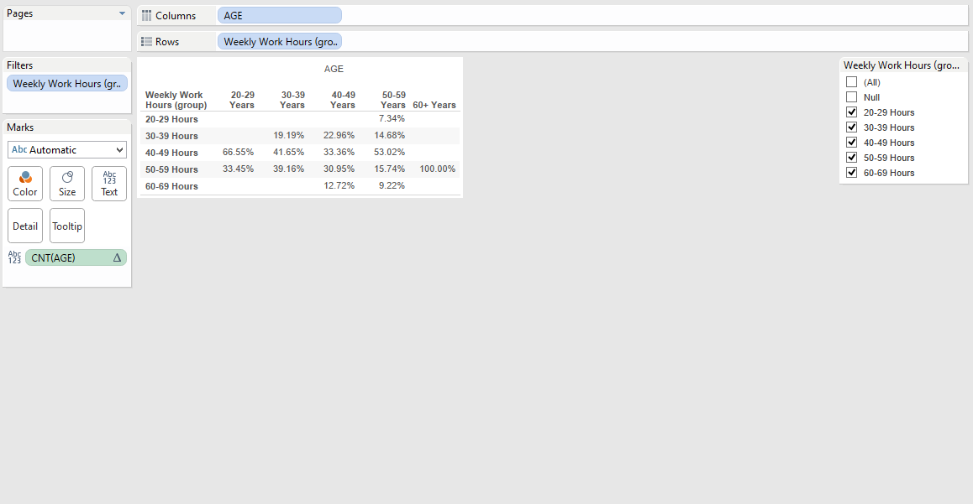
Age vs Weekly Work Hours
Columns – Age

Slide 73
Age vs Weekly Work Hours
Rows – Weekly Work Hours

Slide 74
Age vs Weekly Work Hours
Grouped the work hours into ranges in increments of 10

Slide 75
Age vs Weekly Work Hours
Took out the null values from weekly work hours

Slide 76
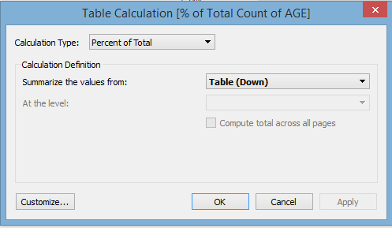
Age vs Weekly Work Hours
Calculated percentages of how many hours worked every week by age group

Slide 77
Age vs Weekly Work Hours
*The majority of employees in their 20’s and 50’s average worked 40-49 hours a week

Slide 78
Age vs Weekly Work Hours
*The majority of employees in their 30-40’s average worked 40-59 hours a week

Slide 79
Age vs Weekly Work Hours
*The majority of employees in their 60+’s average worked 50-59 hours a week

Slide 80
Age vs Weekly Work Hours
*The majority of employees overall worked on average 40-59 hours a week

Slide 81
Additional Tableau Visualizations

Slide 82
Measure vs. Sleep Quality
Sleep Quality
Quality of sleep
(1-5, 1=very poor, 5=very good)
Falling Asleep
Ease of falling asleep
(1-5, 1=very difficult, 5=very easy)
Health Status
Self assessment of health status
(1-4, 1=poor, 4=excellent)

Slide 83
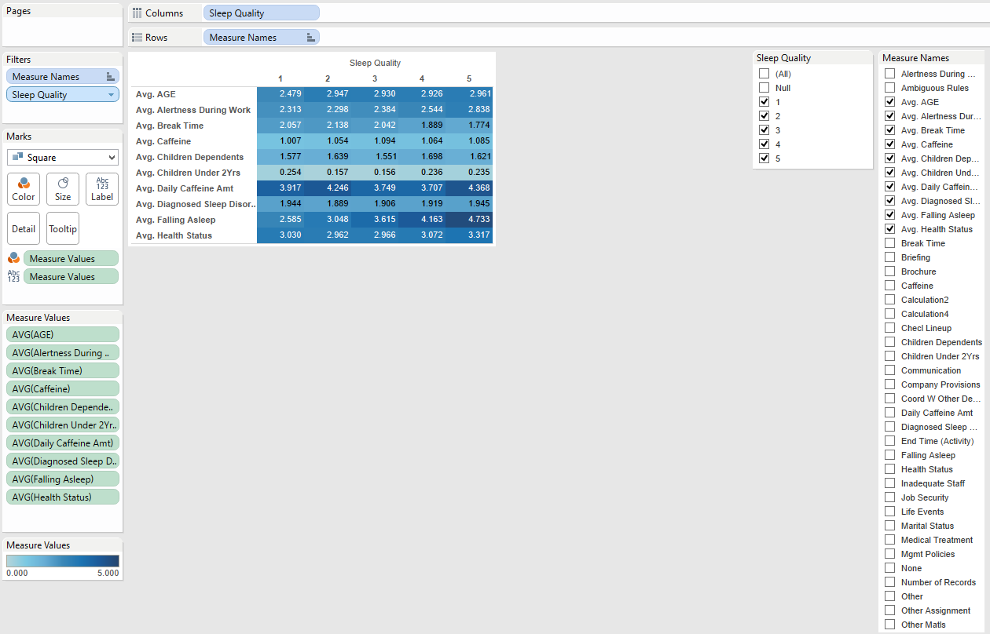
Measure vs Sleep Quality

Slide 84
Measure vs Sleep Quality

Slide 85
Measure vs Sleep Quality

Slide 86
Measure vs Sleep Quality

Slide 87
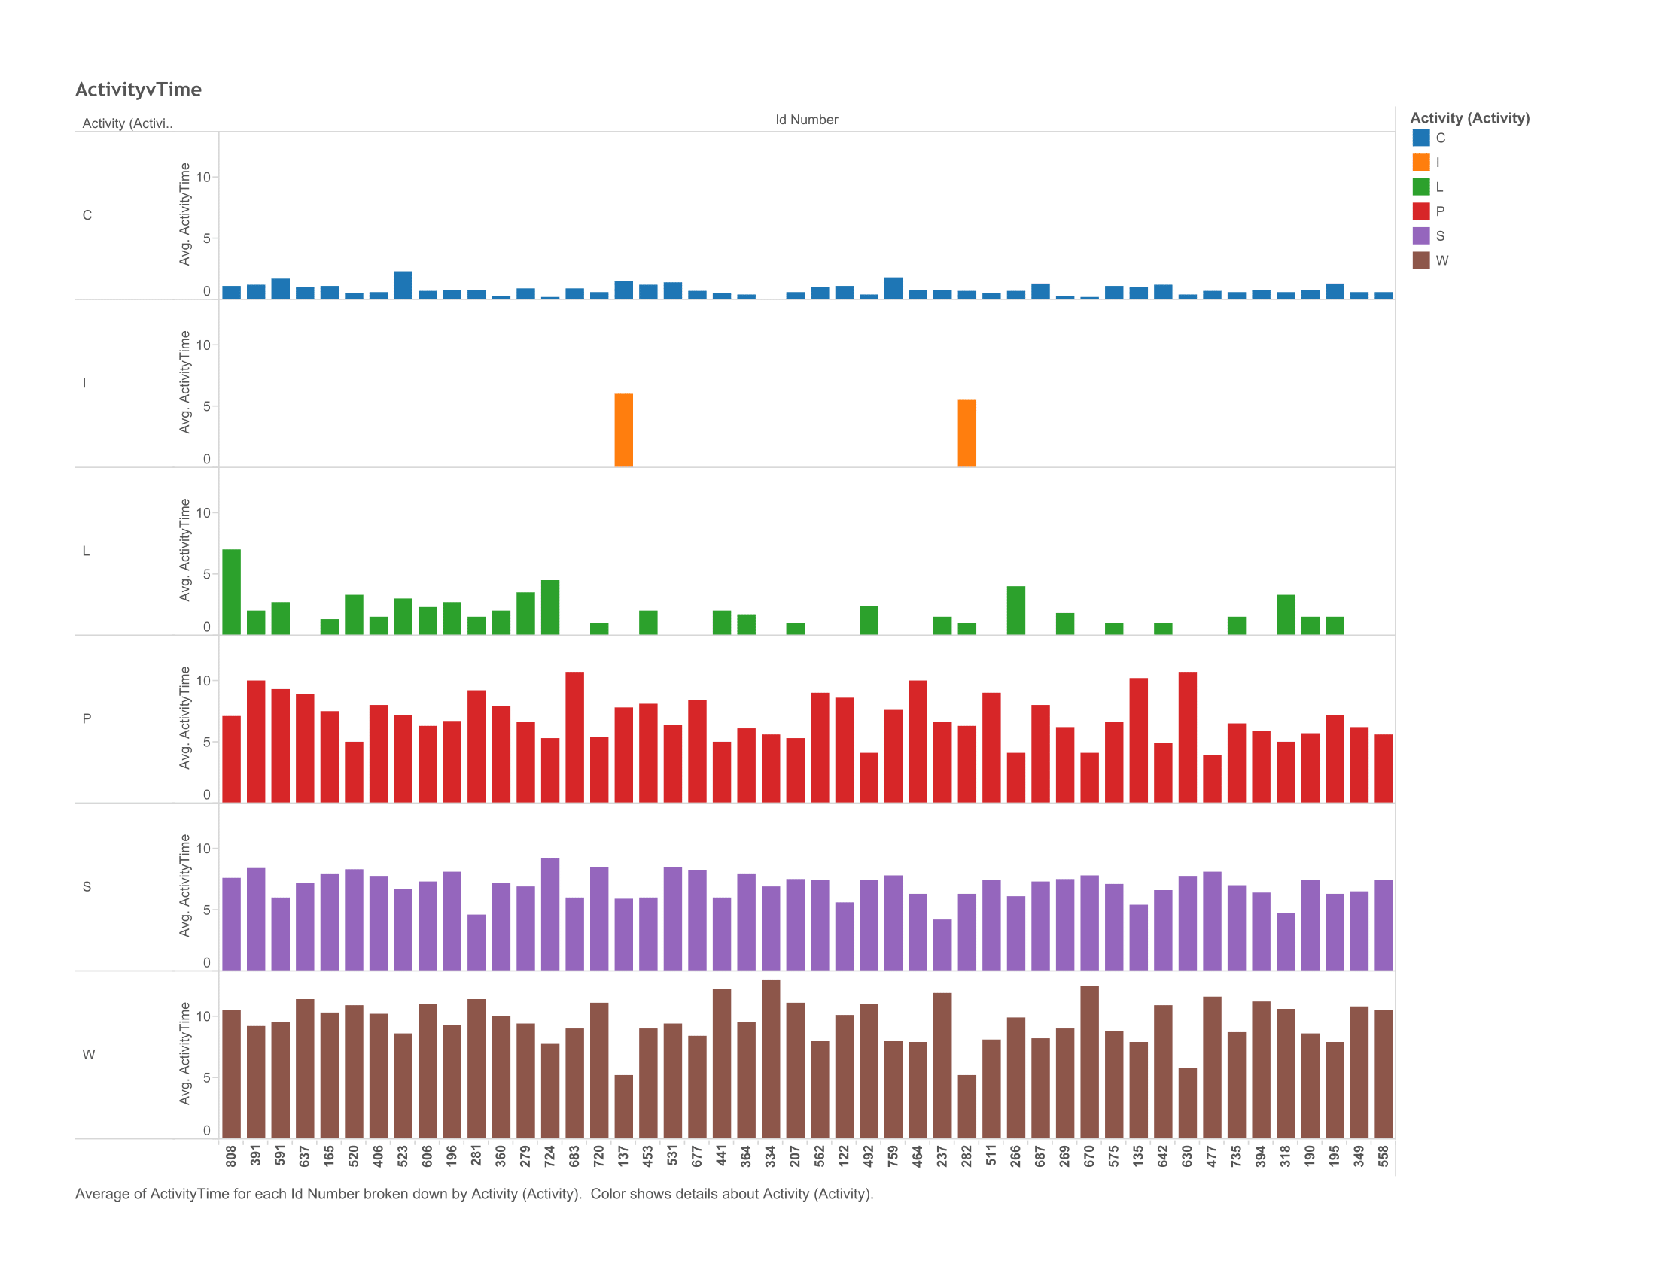
Time per Activity Type

Slide 88
Time per Activity Type
ID Number
Participant ID Number
Activity
Type of Activity
(S=Sleep, P=Personal, C=Commute, W=Work, L=Limbo, I=Interim Release)

Slide 89
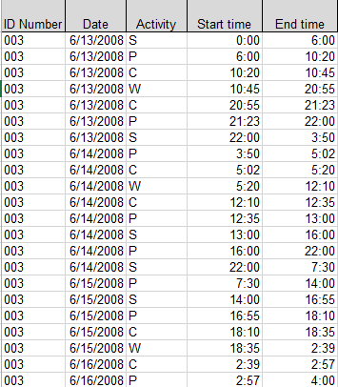
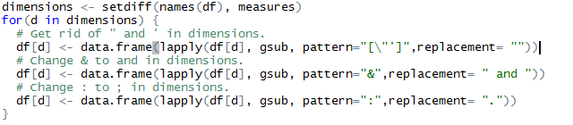
Time per Activity Type
Reformatting the Data

Slide 90
Time per Activity Type
Created calculated field
IF [Start Time (Activity)]>[End Time (Activity)]
THEN 24 - [Start Time (Activity)] + [End Time (Activity)]
ELSE [End Time (Activity)] - [Start Time (Activity)] END

Slide 91
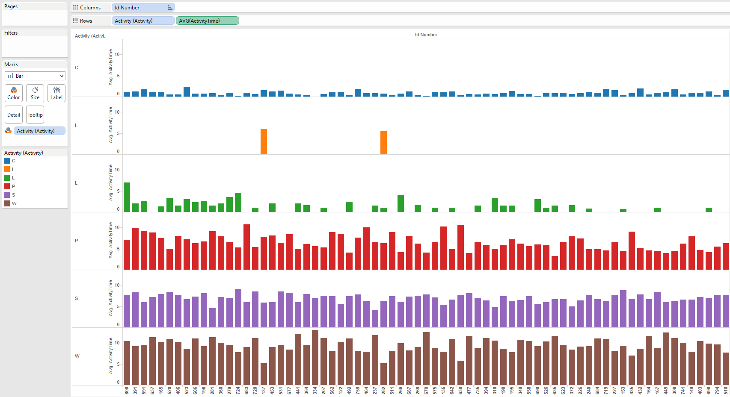
Time per Activity Type

Slide 92
Time per Activity Type

Slide 93
Time per Activity Type

Slide 94
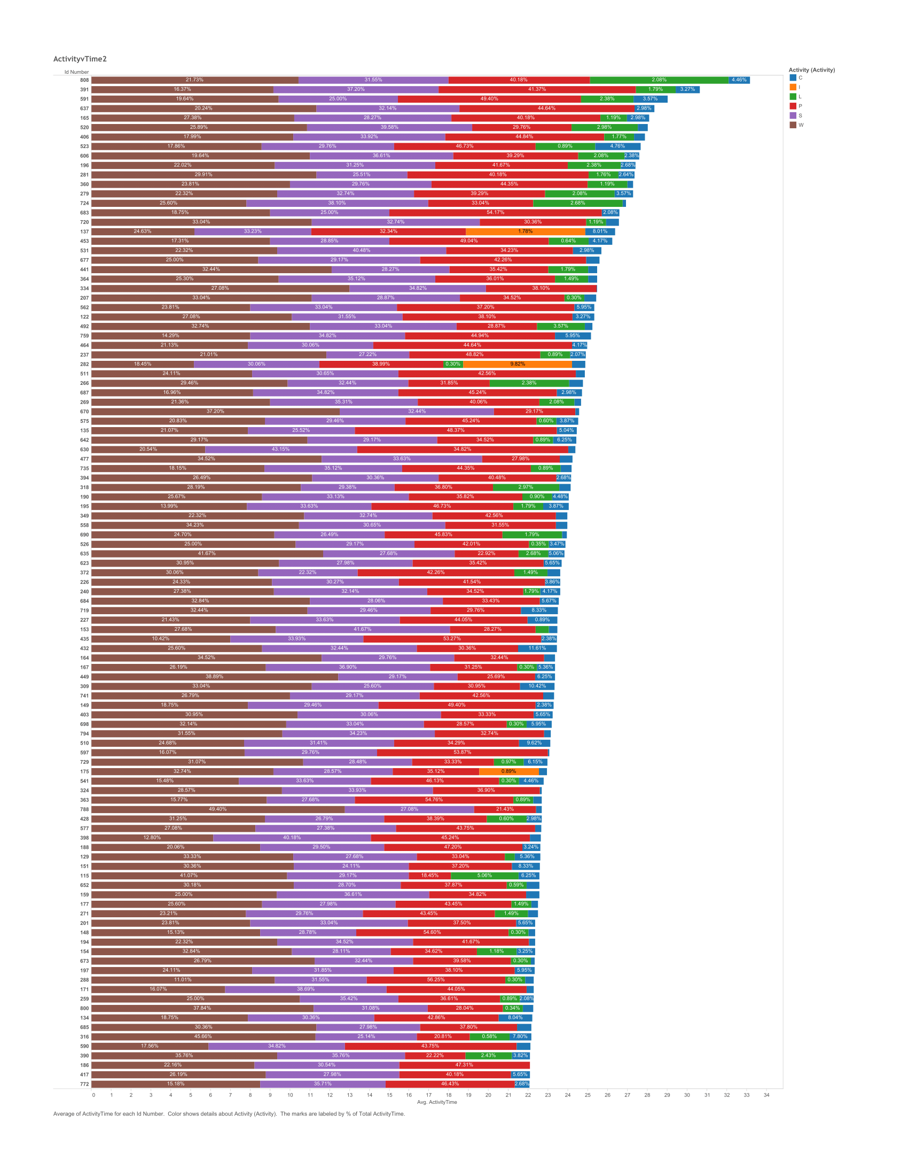
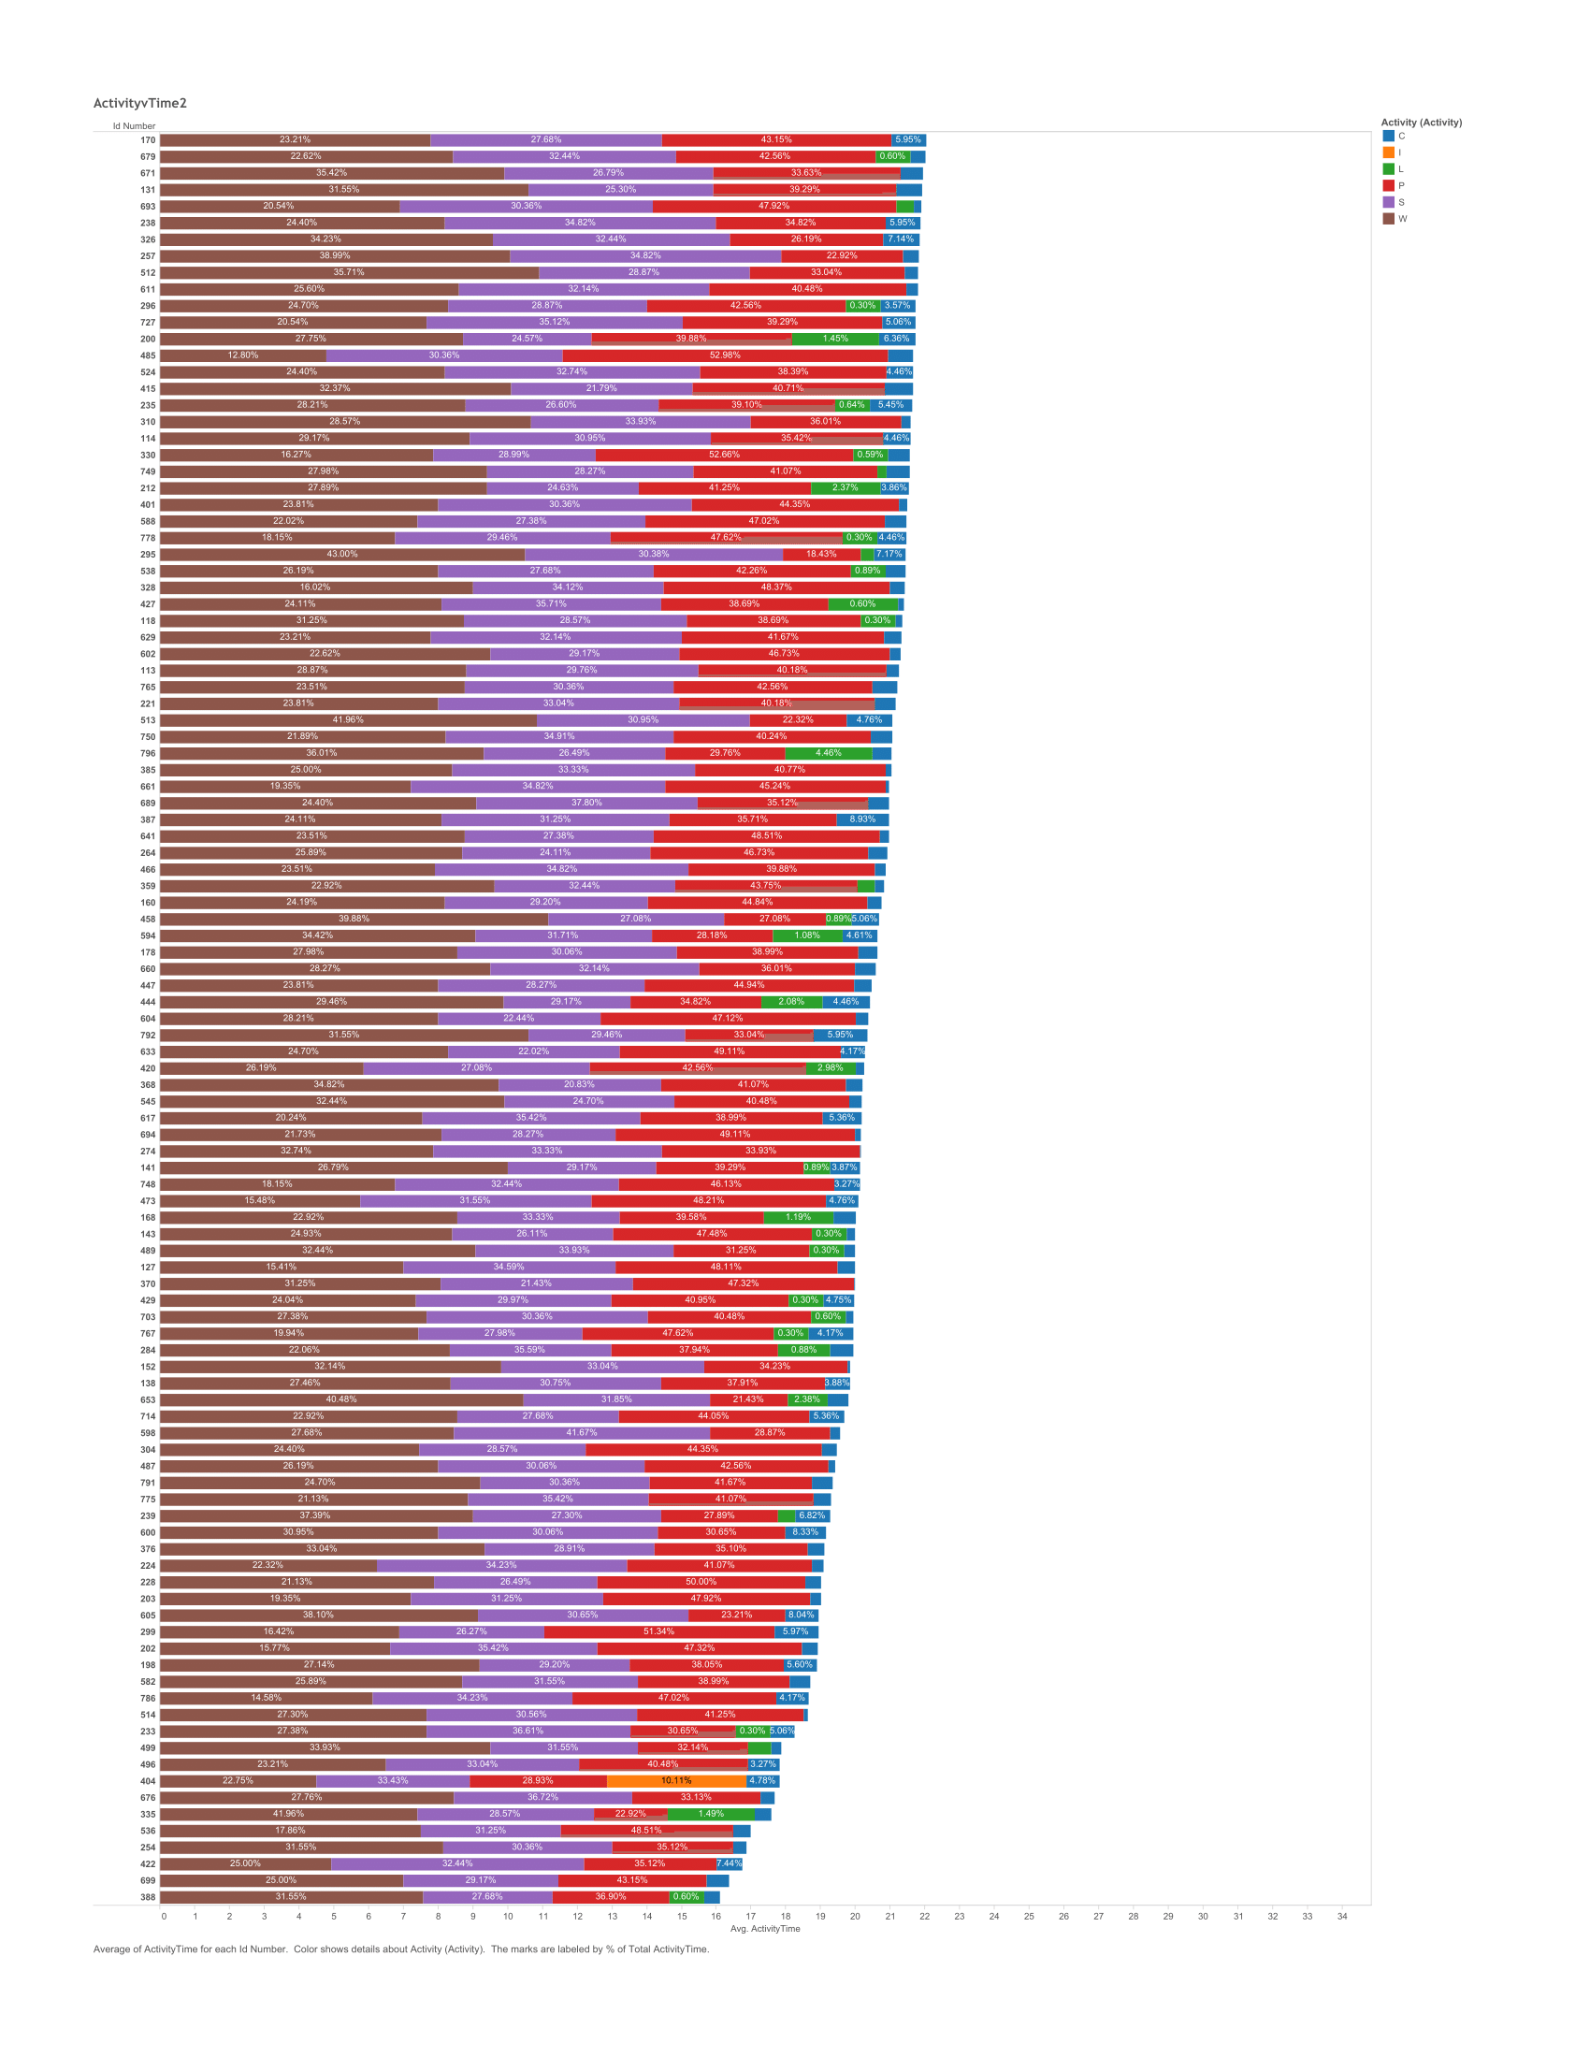
Time per Activity Type v2

Slide 95
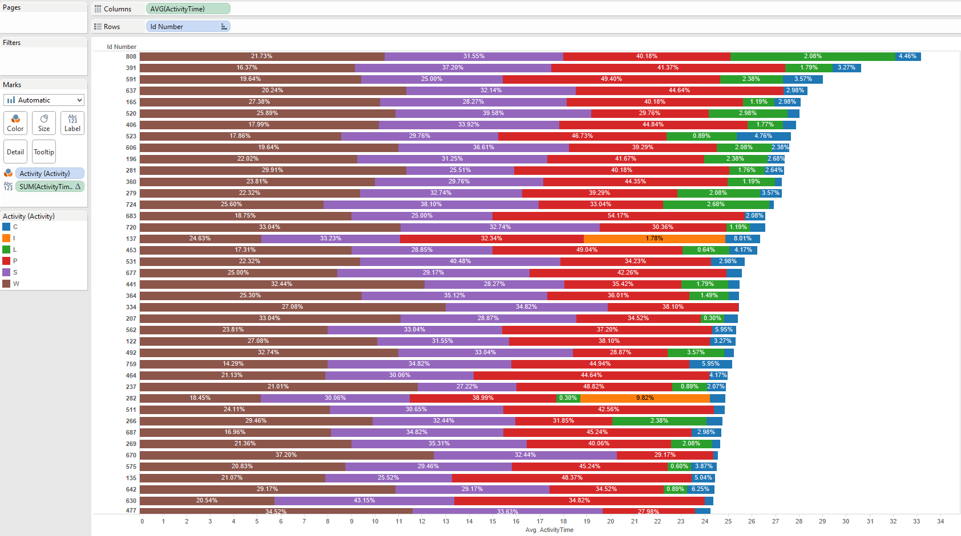
Time per Activity Type v2

Slide 96
Time per Activity Type v2

Slide 97
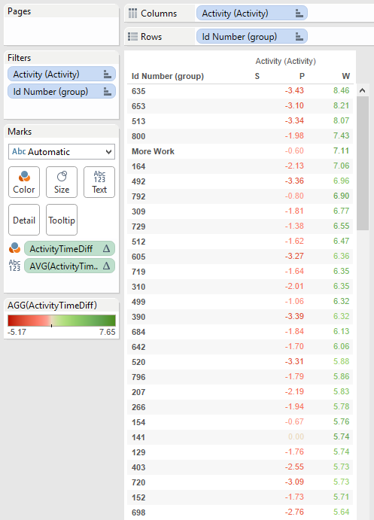
Creating Groups
Filtered by most time consuming activities
Calculated difference from activity S (sleep)
ZN(AVG([ActivityTime (copy)])) - LOOKUP(ZN(AVG([ActivityTime (copy)])), -1)

Slide 98
Group Analysis
ID Number
Participant ID number
Falling Asleep
Ease of falling asleep
(1-5, 1=very difficult, 5=very easy)
Sleep Quality
Quality of sleep
(1-5, 1=very poor, 5=very good)

Slide 99
Group Analysis
Sleep Length
Length of sleep
(1-5, 1=wholly insufficient, 5=more than sufficient
Sleep Loss
Stress due to loss of sleep
(1=no stress, 2=a little stress, 3=frequently, 4=always)
Caffeine Amount
If drink caffeine, how many daily

Slide 100
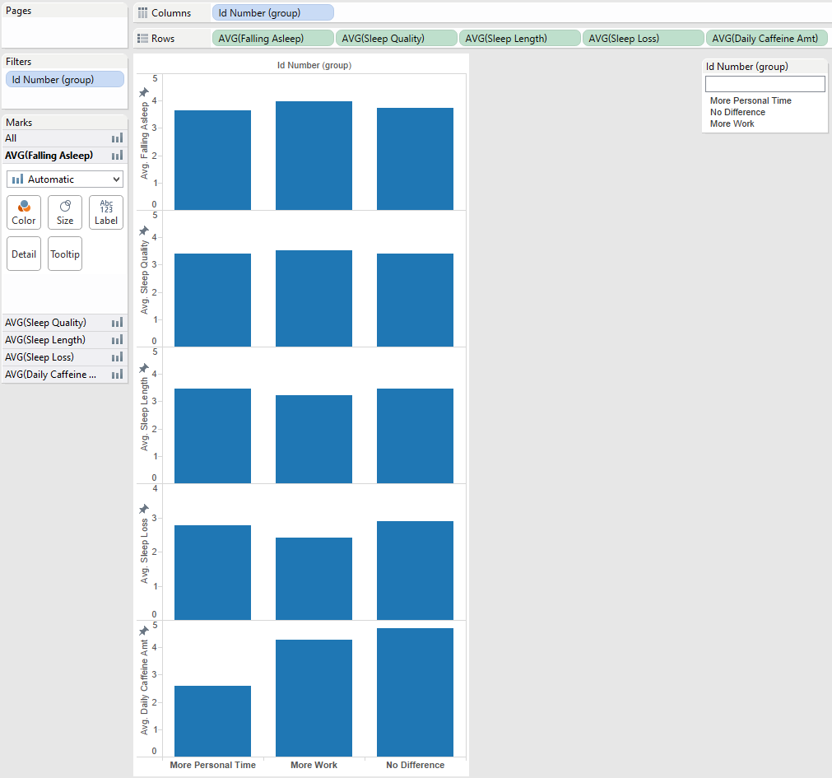
Group Analysis

Slide 101
Group Analysis

Slide 102
Group Analysis

Slide 103
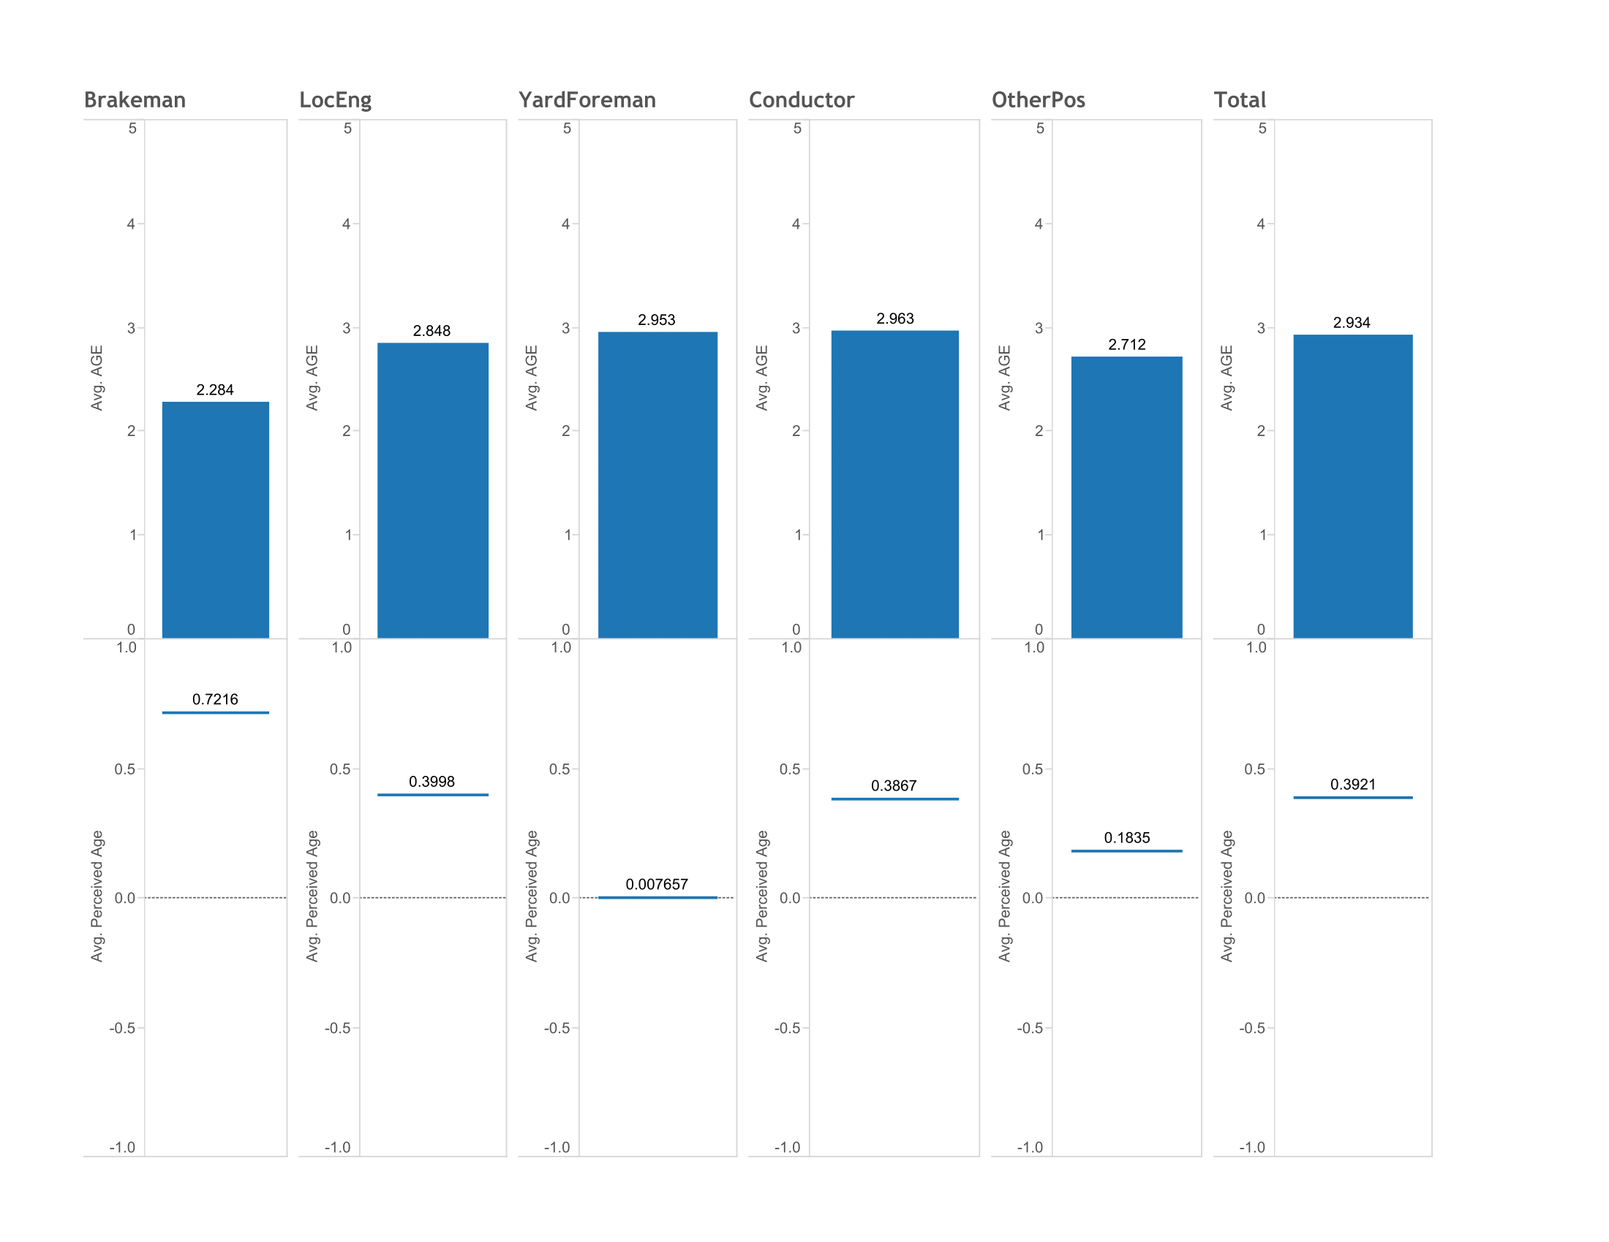
Job and Age Status
Jobs titles as dimensions
Separate worksheets
Utilized dashboard

